Slide 1
PriorDepth
Advanced Topics in 3D Computer Vision Praktikum
Team: Rahul, Halil, Konstantin
Advisor: Patrick Ruhkamp
Final Presentation

Slide 2
PriorDepth - Problem Definition
Task 3: Unsupervised Depth Estimation from Sparse Spatial-Temporal Priors
Building Depth Estimation and Ego-Motion Estimation Pipeline, applicable for Outdoor and Indoor Cameras
Accurate Depth Estimation for slow and fast moving Cameras, including Hand Held Cameras
For the base networks we use MonoDepth2^{[1]} and KeypointNet2D^{[2]}
The pipeline structure is adapted from KeypointNet3D^{[3]}
Pose Estimation for losses should be computed with a Differentiable Ego-Motion Estimator.
for end to end training.
1.Godard, C. et al. (2019) Digging Into Self-Supervised Monocular Depth Estimation (ICCV)
2.Tang, J. et al. (2019) Neural Outlier Rejection for Self-Supervised Keypoint Learning (ICLR)
3.Jiexiong Tang; Self-Supervised 3D Keypoint Learning for Ego-motion Estimation, 2020

Slide 3
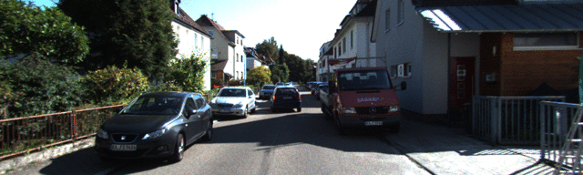
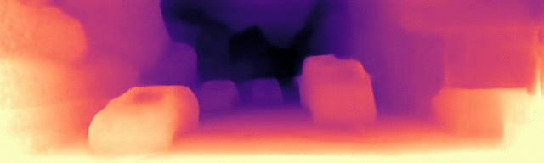
PriorDepth - Motivation Robust Depth Estimation
Depth Estimations are reproduced from MonoDepth2^{[1]} on Kitti^{[2]}
1.Godard, C. et al. (2019) Digging Into Self-Supervised Monocular Depth Estimation (ICCV)
2.Geiger, A., et al. “Vision Meets Robotics: The KITTI Dataset.” The International Journal of Robotics Research, vol. 32, no. 11, Sept. 2013

Slide 4
PriorDepth - Motivation for Robust Depth Estimation
Depth Estimation Circumstances
Outdoor
Indoor
vs.
Hand Held Camera
Steady Cameras
Similar Pace
Diverse Pace
1.Godard, C. et al. (2019) Digging Into Self-Supervised Monocular Depth Estimation (ICCV)

Slide 5
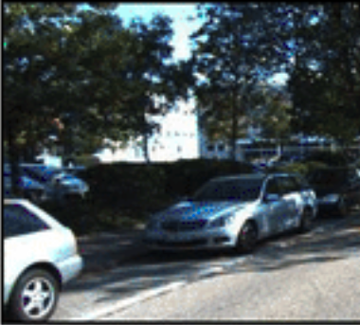
Priordepth - MonoDepth2
Monodepth Structure
PoseNet Encoder/Decoder
Pose
MonoDepth 2 Encoder/Decoder
Image Reprojection Loss
1. Godard, C. et al. (2019) Digging Into Self-Supervised Monocular Depth Estimation (ICCV)
2. Kendall, A. et al. (PoseNet: A Convolutional Network for Real-Time 6-DOF Camera Relocalization

Slide 6
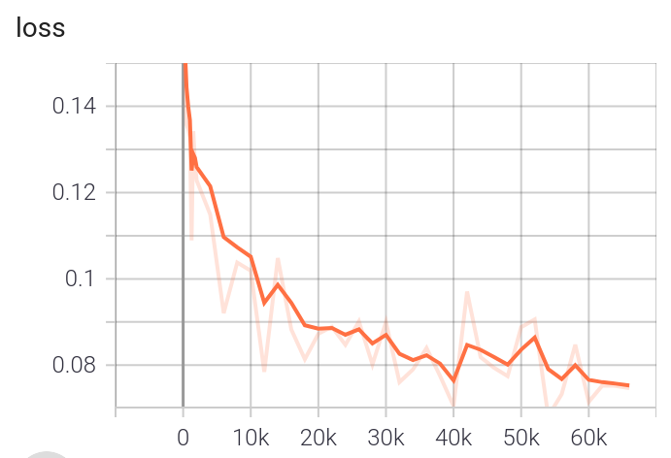
Priordepth - MonoDepth2
Monodepth Reproduction
Training Settings:
20 Epochs, adam optimizer, Batch size = 12, Lr = 1e-3
Eigen Zhou split with around 44 000 images 10% validation 90% training
ImageNet Pretrained (default)
 | Abs Rel | Sq Rel | RMSE | RMSE log
Reproduction Model | 0.1493 | 0.87 | 5.016 | 0.1927
Monodepth2 | 0.132 | 1.044 | 4.872 | 0.210
1. Godard, C. et al. (2019) Digging Into Self-Supervised Monocular Depth Estimation (ICCV)

Slide 7
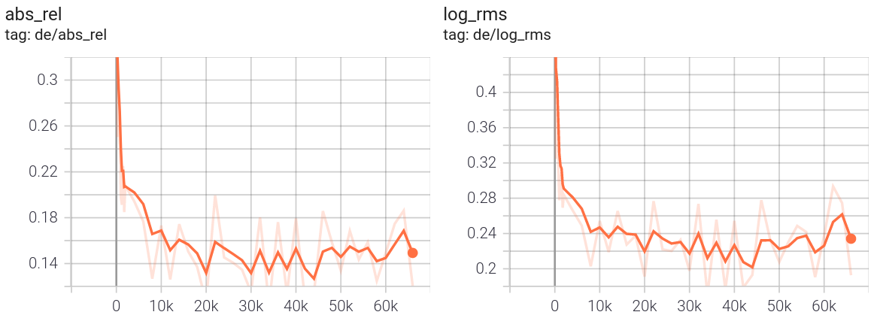
Priordepth - Monodepth 2
Monodepth Reproduction - Fast Convergence
1.Godard, C. et al. (2019) Digging Into Self-Supervised Monocular Depth Estimation (ICCV)

Slide 8

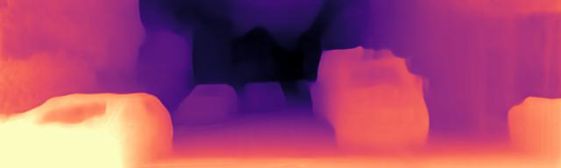

Priordepth - Monodepth 2
Monodepth Drawbacks
Monodepth2^{[1]} uses PoseNet
Trained on kitti - slow driving in input frames
PoseNet Overfitting -> Pose is used in Loss Calculation
Unuseable for in-door data and most other datasets
3 consecutive Depth estimations with
own reproduced Monodepth 2
1.Godard, C. et al. (2019) Digging Into Self-Supervised Monocular Depth Estimation (ICCV)

Slide 9
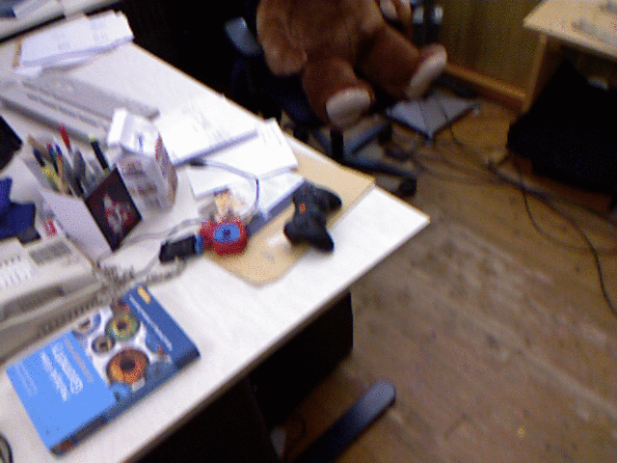
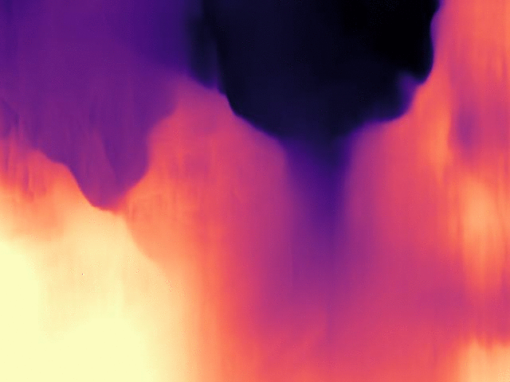
Priordepth - Monodepth 2
Monodepth Drawbacks
RGBD Indoor Dataset^{[2]}
Depth Estimation^{[1]}
1. Godard, C. et al. (2019) Digging Into Self-Supervised Monocular Depth Estimation (ICCV)
2. J. Sturm and N. et al. (2012) A Benchmark for the Evaluation of RGB-D SLAM Systems

Slide 10
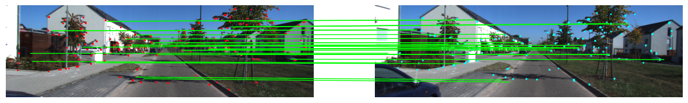
PriorDepth – General Idea
Unsupervised Depth and Ego-Motion Estimation with Temporal Consecutive Monocular View using Keypoints
Goal: Predict better Poses to formulate better reprojection loss, improving depth estimation for indoor scenes and close ranges
Input Data
Differentiable Ego Motion Estimation through epipolar geometry.
Pose
KeyPointNet2D^{[2]}
KeyPoints and Descriptors
Image Reprojection Loss
MonoDepth2^{[1]}
Depth
1.Godard, C. et al. (2019) Digging Into Self-Supervised Monocular Depth Estimation (ICCV)
2.Tang, J. et al. (2019) Neural Outlier Rejection for Self-Supervised Keypoint Learning (ICLR)

Slide 11
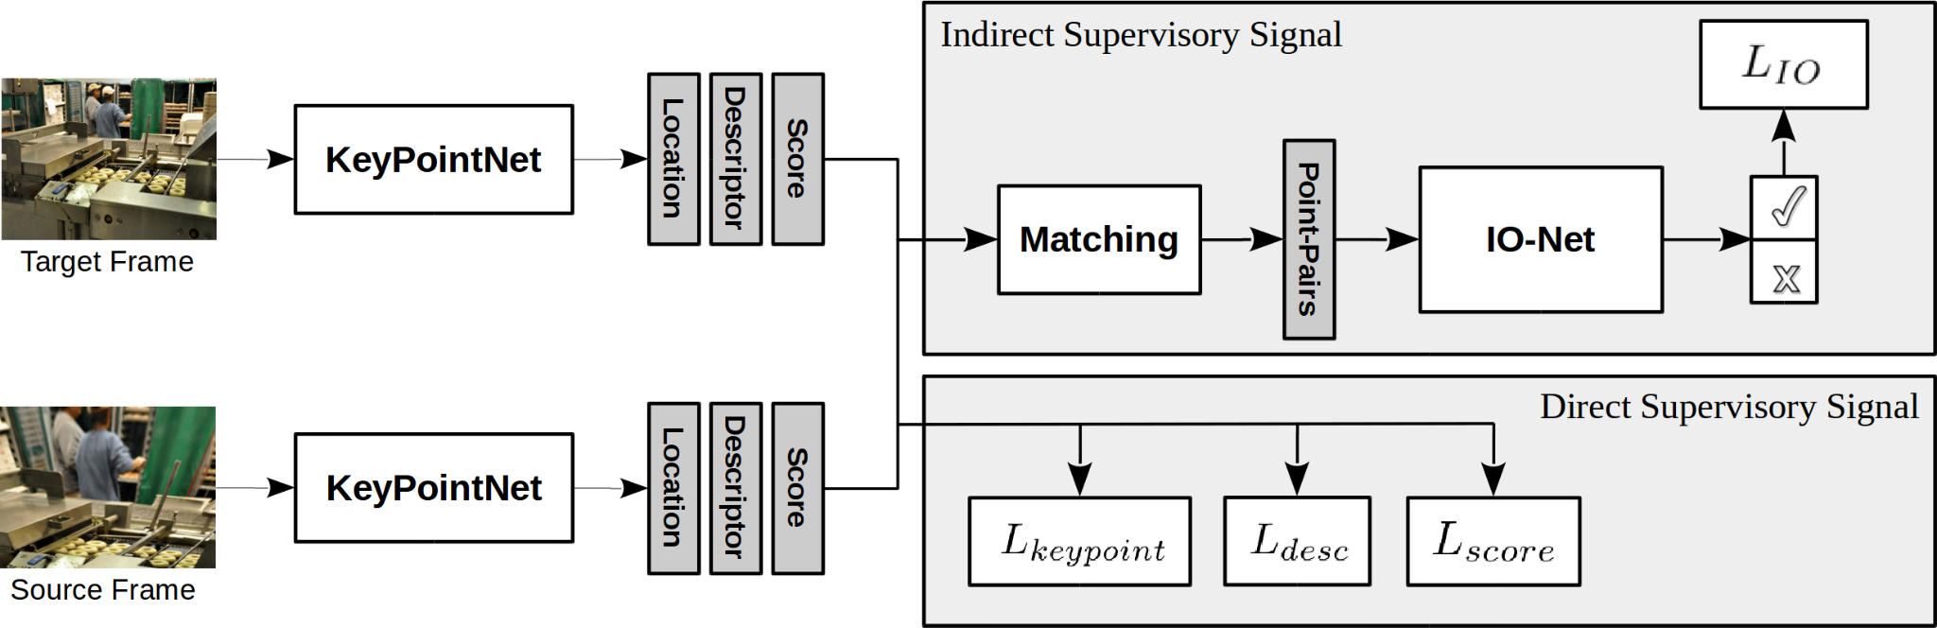
PriorDepth – KP2D^{[1]}
Improve Outlier Rejection
Extracts the keypoints, descriptors and the scores
Keypoint Loss
Distance between the target keypoint and warped source keypoint
Descriptor Loss
Per pixel Triplet Loss on distance between the descriptors
+ve and -ve samples from keypoint correspondences between the images
Score Loss
Minimize the distance between scores of keypoint pairs + min./max. the average scores of keypoint pair
[1] Tang, Jiexiong, et al. “Neural Outlier Rejection for Self-Supervised Keypoint Learning.” ArXiv:1912.10615

Slide 12
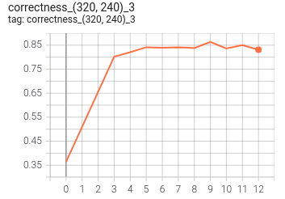
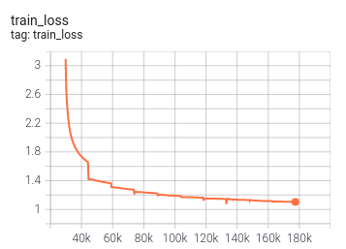
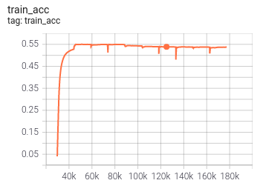
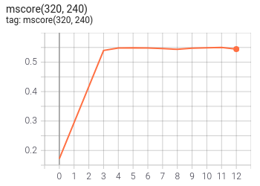
PriorDepth – KP2D
Validation on HPatches^{[2]}
Training on COCO^{[1]} 2017 (Train set)
Validation Metrics | Our Training (12 epochs) | Results from the paper (50 epochs) | Progress
C1 | 0.493 | 0.593 | ↑
C3 | 0.831 | 0.867
C5 | 0.893 | 0.91
Matching Score | 0.544 | 0.546
Repeatability | 0.660 | 0.687
Localization | 0.913 | 0.892 | ↓
[1]Tsung-Yi Lin, et al. "Microsoft COCO: Common Objects in Context." (2015).
[2]Vassileios Balntas, et al. "HPatches: A benchmark and evaluation of handcrafted and learned local descriptors." (2017).
Notes:
Repeatability. The repeatability is the ratio of correctly associated points after warping into the target frame. The association is performed by selecting the closest in-view point and comparing the distance with the correctness distance threshold.
Localization Error. The localization error is calculated by averaging the distance between warped points and their associated points.
Matching Score (M.Score). The matching score is the success rate of retrieving correctly associated points through nearest neighbour matching using descriptors. Homography Accuracy. The homography accuracy is the success rate of correctly estimating the homographies. The mean distance between four corners of the image planes and the warped image planes using the estimated and the groundtruth homography matrices are compared with distances 1, 3, 5. To estimate the homography, we perform reciprocal descriptor matching, and we use openCV’s f indHomography method with RANSAC, maximum number of 5000 iterations, confidence threshold of 0.9995 and error threshold 3

Slide 13
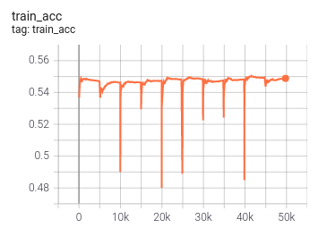
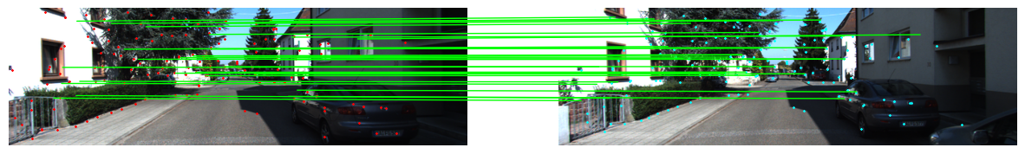
PriorDepth – KP2D
Pretraining on KITTI^{[1]} - Eigen Zhou split
Help the network navigate the domain shift with pre-training
Use model that performs well on KITTI to plug into KP3D baseline model and freeze the network for initial configurations.
Figure - Visualisation of the matched keypoints on KITTI from KeypointNet
[1] Geiger, A., et al. “Vision Meets Robotics: The KITTI Dataset.” The International Journal of Robotics Research, vol. 32, no. 11, Sept. 2013

Slide 14
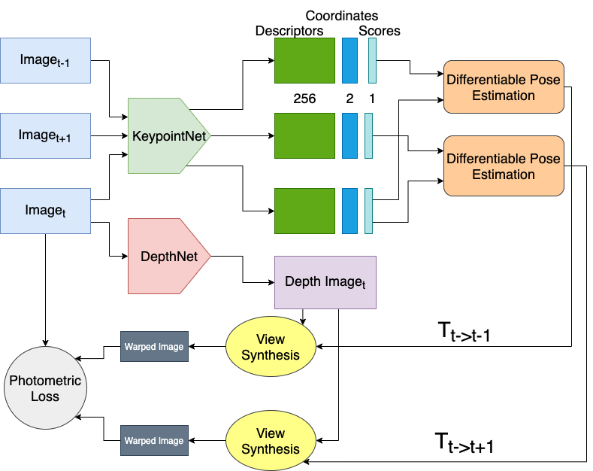
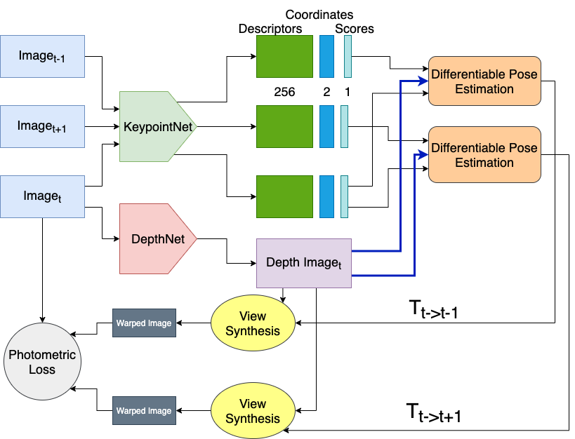
Priordepth - KP3D^{[1]}
PriorDepth - Pose with Essential Matrix
PriorDepth - Pose with Perspective-n-Point
[1] Tang, Jiexiong, et al. “Self-Supervised 3D Keypoint Learning for Ego-Motion Estimation”

Slide 15
PriorDepth - KP3D
Possible Training Configurations
Train DepthNet
UnFrozen KeyPointNet
Frozen KeyPointNet
Homographic warping
+
Perspective Warping
{
Pose Estimator
Homographic warping
Essential Matrix based Pose
PnP based Pose
As Proposed in KP2D^{[1]}
Our Extensions
[1] Tang, Jiexiong, et al. “Neural Outlier Rejection for Self-Supervised Keypoint Learning.” ArXiv:1912.10615

Slide 16
PriorDepth - Pose from Essential Matrix Expanded
Get keypoint feature descriptors, coordinates, and scores from KeyPointNet
Scores
Match
Matched Descriptor Distance
Symmetric Epipolar Distance
Calculate Essential Matrix
Calculate Relative Pose
Filter Blocks
Processing Blocks

Slide 17
PriorDepth - Pose from PnP Expanded
Get keypoint feature descriptors, coordinates, and scores from KeyPointNet
Scores
Match
Matched Descriptor Distance
Symmetric Epipolar Distance
Get Depth from DepthNet
Reproject to 3D coordinates
Get 2D-3D correspondences
Filter Blocks
Processing Blocks
Calculate Relative Pose using PnP

Slide 18
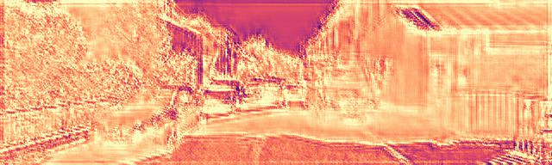
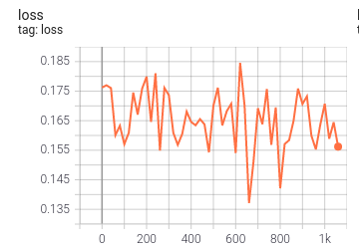
PriorDepth - Results and Challenges
PriorDepth - KITTI
DepthNet^{[1]} trained with PoseNet
Our Implementation based on Differential Pose Estimation
Inaccurate Depth is also reflected in the training curves.
1.Godard, C. et al. (2019) Digging Into Self-Supervised Monocular Depth Estimation (ICCV)

Slide 19
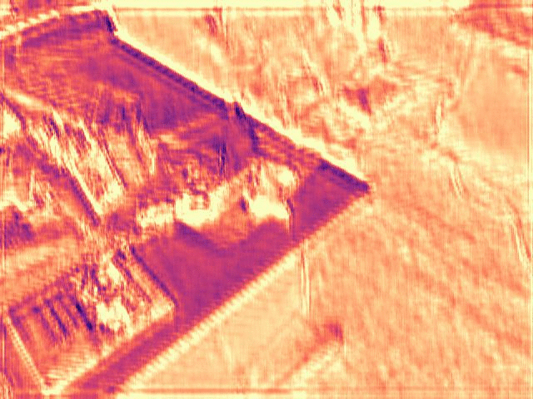
PriorDepth - Results and Challenges
PriorDepth - Indoor Data
DepthNet trained
with PoseNet
Our Implementation based on Differential Pose Estimation
Original^{[1]}
1. J. Sturm and N. et al. (2012) A Benchmark for the Evaluation of RGB-D SLAM Systems

Slide 20
PriorDepth
Debug Process
Get keypoint feature descriptors, coordinates, and scores from KeyPointNet
Match
Pose
Get Depth from DepthNet
Does our Matching work?

Slide 21
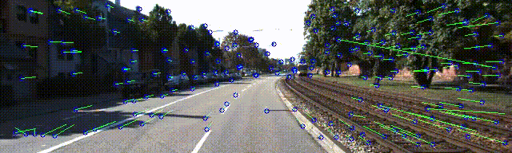
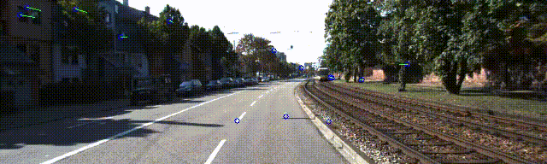
PriorDepth
Debug Process
Before Filtering
After Filtering
Matching Works! Our keypoint filters also work.
Let’s check for warped image from calculated poses

Slide 22
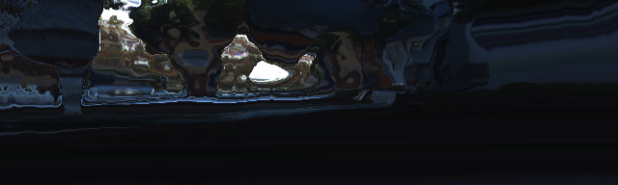
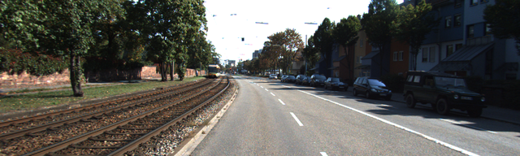
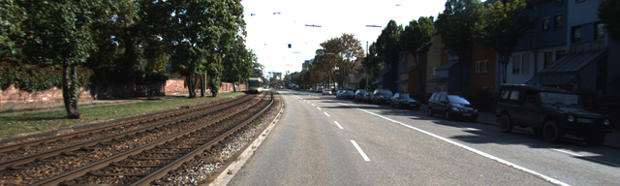

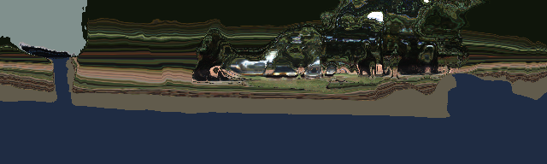
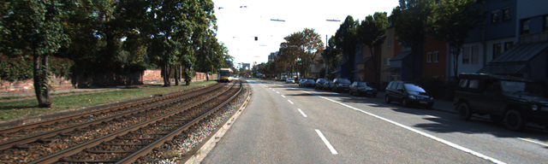
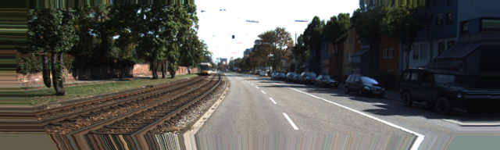
PriorDepth - 2D & 3D homography warping
-1
0
1
Ours
From PoseNet^{[1]}
1. Godard, C. et ai. (2019) Digging Into Self-Supervised Monocular Depth Estimation (ICCV)

Slide 23

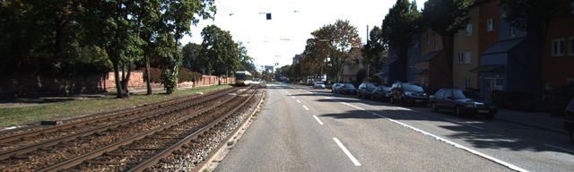
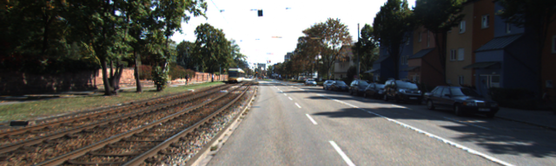


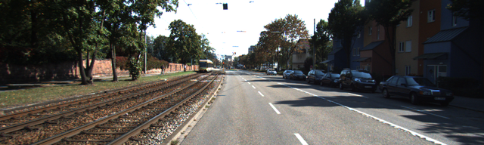
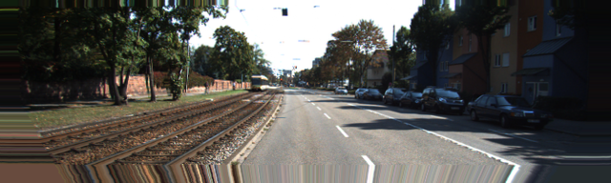
PriorDepth - 2D & 3D homography warping PnP
-1
0
1
Ours
From PoseNet^{[1]}
1. Godard, C. et al. (2019) Digging Into Self-Supervised Monocular Depth Estimation (ICCV)

Slide 24
PriorDepth - Summary
We tried to build an end to end differentiable pipeline for robust depth and ego motion estimation
The loss values did not converge on training and the visualisations also showed the network could no train.
On further debugging, we found that the matching and subsequent keypoint filters worked.
After subsequent trials, it was found that the pose calculations were not accurate due to errors in estimating fundamental matrix.
Due to inaccurate pose estimations, warping failed and hence, DepthNet was unable to train itself.

Slide 25
Thank you for the attention!
Questions?

Slide 26
Priordepth - Monodepth 2
Monodepth Drawbacks
PoseNet Overfitting trained on Kitti
Car often slowly moving (before curves)
Often with constant pace and straight line
Monodepth produces bad outputs for fast camera movement like handheld cameras

Slide 27
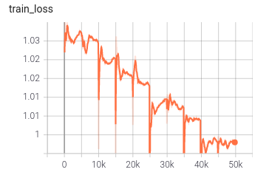
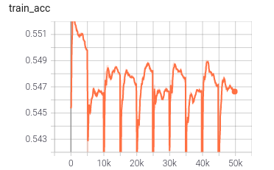
PriorDepth – KP2D
Help the network navigate the domain shift with pre-training
Pretraining on KITTI^{[4]} - Eigen Zhou split
Use model that performs well on KITTI to plug into KP3D baseline model and freeze the network.
Figure - Visualisation of the matched keypoints on KITTI from KeypointNet
[4] Geiger, A., et al. “Vision Meets Robotics: The KITTI Dataset.” The International Journal of Robotics Research, vol. 32, no. 11, Sept. 2013

Slide 28
Priordepth - KeypointNet 2D
KeypointNet 2D Drawbacks

Slide 29
PriorDepth - Pose from Essential Matrix
Initial keypoint feature descriptors, coordinates, and scores from KP2D
Filter out keypoints based on:
Score threshold
Descriptor-distance threshold
Distance on epipolar line
Compute pose from keypoints left and essential matrix
1. Godard, C. et alii. (2019) Digging Into Self-Supervised Monocular Depth Estimation (ICCV)
2. J. Sturm and N. et alii. (2012) A Benchmark for the Evaluation of RGB-D SLAM Systems

Slide 30
PriorDepth - Pose from Perspective-n-Points
Initial keypoint feature descriptors, coordinates, and scores from KP2D
Filter out keypoints based on:
Score threshold
Descriptor-distance threshold
Distance on epipolar line
Reproject keypoints left to 3D using depth map estimated from target image
Compute pose using Perspective-n-Point algorithm with 2D-3D keypoint correspondences
1. Godard, C. et alii. (2019) Digging Into Self-Supervised Monocular Depth Estimation (ICCV)
2. J. Sturm and N. et alii. (2012) A Benchmark for the Evaluation of RGB-D SLAM Systems

Slide 31
PriorDepth – KP2D^{[1]}
Improve Outlier Rejection
Extracts the keypoints, descriptors and the scores
Keypoint Loss
Distance between the target keypoint and warped source keypoint
Descriptor Loss
Per pixel Triplet Loss on distance between the descriptors
+ve and -ve samples from keypoint correspondences between the images
Score Loss
Minimize the distance between scores of keypoint pairs + min./max. the average scores of keypoint pair
[1] Tang, Jiexiong, et al. “Neural Outlier Rejection for Self-Supervised Keypoint Learning.” ArXiv:1912.10615

Slide 32
Priordepth - KP2D

Slide 33
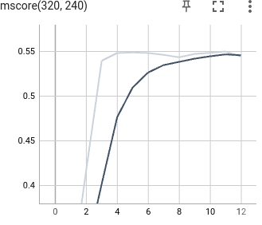
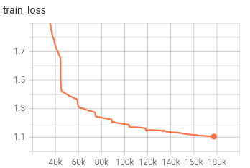
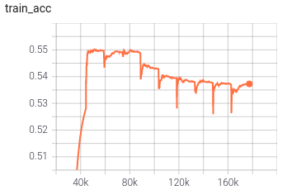
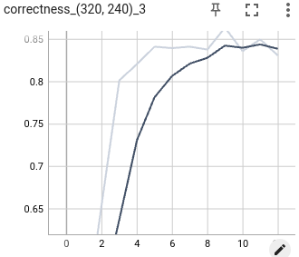
PriorDepth – KP2D
Validation on HPatches^{[3]}
Training on COCO^{[2]} 2017 (Train set)
Validation Metrics | Our Training (12 epochs) | Results from the paper (50 epochs) | Progress
C1 | 0.493 | 0.593 | ↑
C3 | 0.831 | 0.867
C5 | 0.893 | 0.91
Matching Score | 0.544 | 0.546
Repeatability | 0.660 | 0.687
Localization | 0.913 | 0.892 | ↓
[2]Tsung-Yi Lin, et al. "Microsoft COCO: Common Objects in Context." (2015).
[3]Vassileios Balntas, et al. "HPatches: A benchmark and evaluation of handcrafted and learned local descriptors." (2017).

Slide 34
PriorDepth – Timeline
15.05 - 22.05
22.05 - 29.05
29.05 - 05.06
05.06 - 12.06
12.06 - 15.06
planning and research on individual network baselines
Simple testing on individual networks
Offline training approaches
Debugging pipeline
AWS Instance environment setup
AWS test training of networks
Focuses:
Halil: our baseline
Konstantin: Monodepth21
Rahul: KeypointNet2D2
Preparing training datasets offline and on aws
Building own Pipeline with trained networks
1.Godard, C. et alii. (2019) Digging Into Self-Supervised Monocular Depth Estimation (ICCV)
2.Tang, J. et alii. (2019) Neural Outlier Rejection for Self-Supervised Keypoint Learning (ICLR)

Slide 35
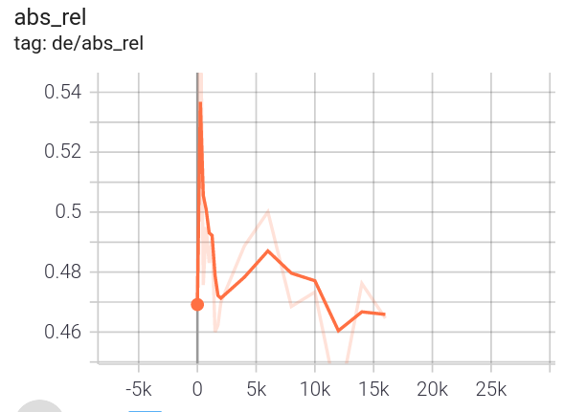
PriorDepth – Monodepth2
Test Training Settings:
15 Epochs, adam optimizer, Batch size = 12, Lr = 1e-3
Eigen Zhou split with around 44 000 images 10% validation 90% training
From scratch
 | Abs Rel | Sq Rel | RMSE | RMSE log
Test Model | 0.4659 | 4.544 | 11.34 | 0.5796
Monodepth2 (after 20 epochs) | 0.132 | 1.044 | 4.872 | 0.210

Slide 36
PriorDepth – KP2D^{[1]}
Improve Outlier Rejection
Extracts the keypoints, descriptors and the scores
Keypoint Loss
Distance between the target keypoint and warped source keypoint
Descriptor Loss
Per pixel Triplet Loss on distance between the descriptors
+ve and -ve samples from keypoint correspondences between the images
Score Loss
Minimize the distance between scores of keypoint pairs + min./max. the average scores of keypoint pair
[1] Tang, Jiexiong, et al. “Neural Outlier Rejection for Self-Supervised Keypoint Learning.” ArXiv:1912.10615

Slide 37
PriorDepth – KP2D
Validation on HPatches^{[3]}
Training on COCO^{[2]} 2017 (Train set)
Validation Metrics | Our Training (12 epochs) | Results from the paper (50 epochs) | Progress
C1 | 0.493 | 0.593 | ↑
C3 | 0.831 | 0.867
C5 | 0.893 | 0.91
Matching Score | 0.544 | 0.546
Repeatability | 0.660 | 0.687
Localization | 0.913 | 0.892 | ↓
[2]Tsung-Yi Lin, et al. "Microsoft COCO: Common Objects in Context." (2015).
[3]Vassileios Balntas, et al. "HPatches: A benchmark and evaluation of handcrafted and learned local descriptors." (2017).

Slide 38
PriorDepth – KP2D
Help the network navigate the domain shift with pre-training
Pretraining on KITTI^{[4]} - Eigen Zhou split
Use model that performs well on KITTI to plug into KP3D baseline model and freeze the network.
Figure - Visualisation of the matched keypoints on KITTI from KeypointNet
[4] Geiger, A., et al. “Vision Meets Robotics: The KITTI Dataset.” The International Journal of Robotics Research, vol. 32, no. 11, Sept. 2013

Slide 39
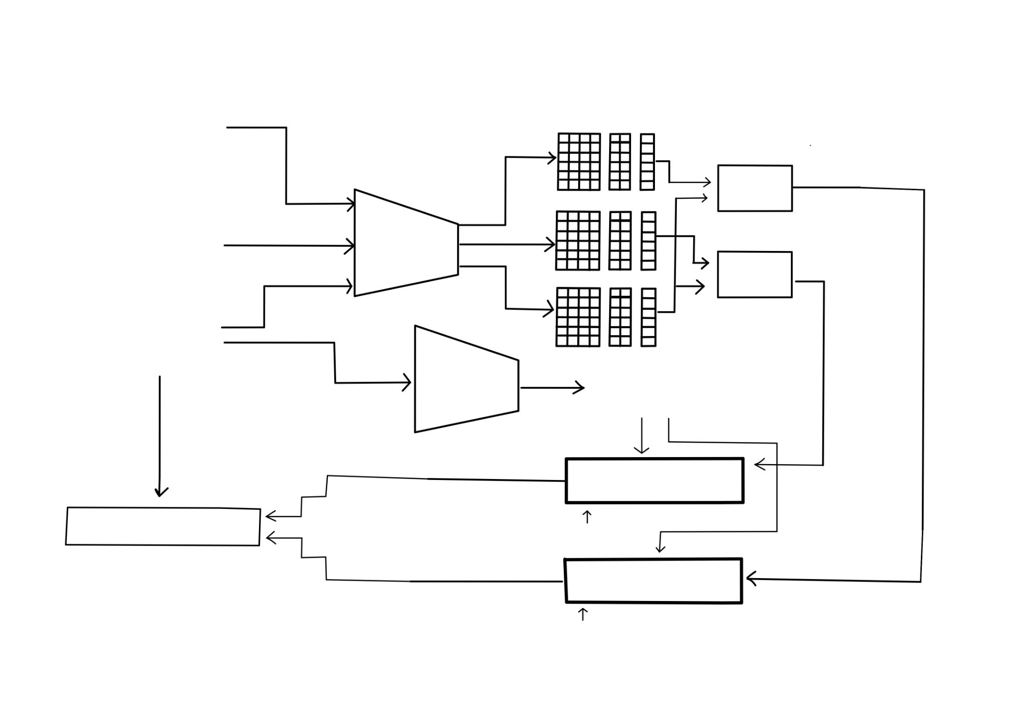
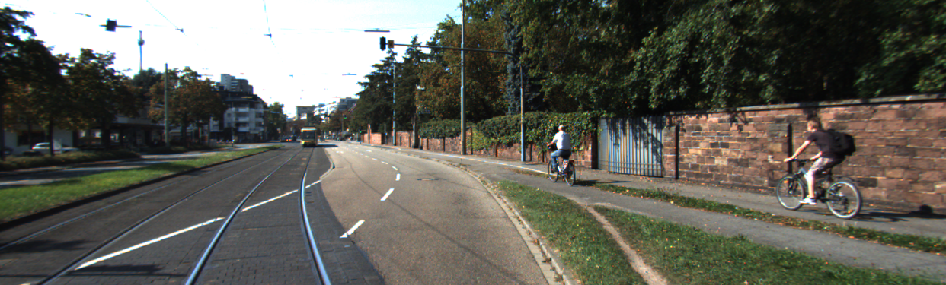
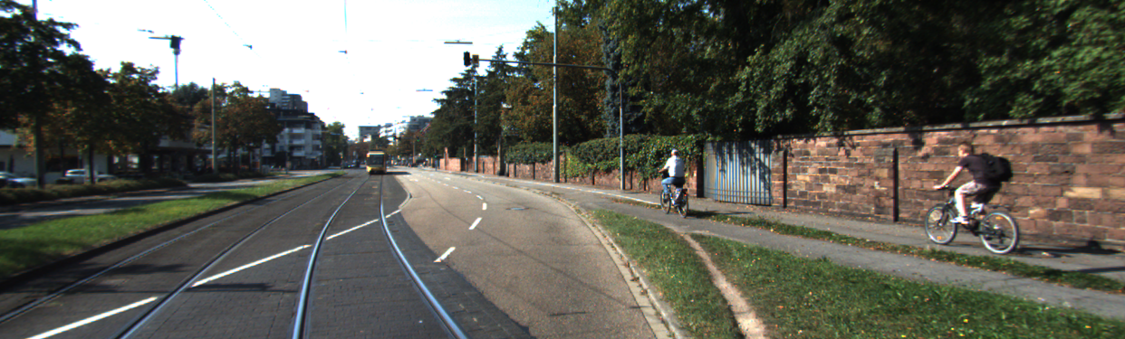
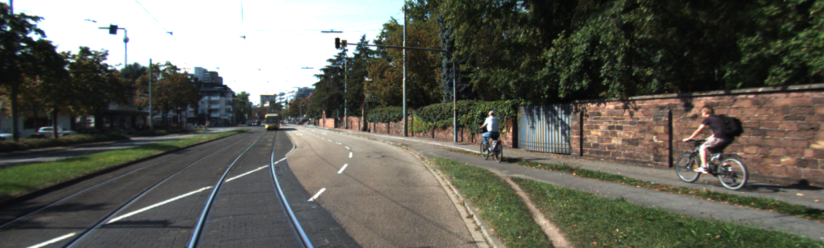

PriorDepth – KP3D Baseline
I_{t-1}
Descriptors
Coordinates
Scores
Pose Estimation
X_{t->t+1}
I_{t+1}
KeypointNet
Pose Estimation
X_{t->t-1}
I_{t}
DepthNet
View Synthesis
Photometric Loss
I_{t-1}
View Synthesis
I_{t+1}
Our Baseline

Slide 40
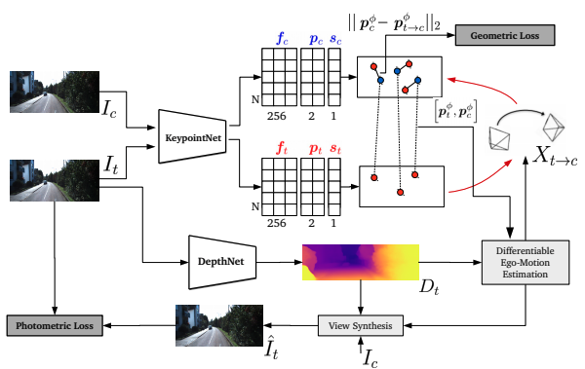
PriorDepth – KP3D Baseline
I_{t-1}
Descriptors
Coordinates
Scores
Pose Estimation
X_{t->t+1}
I_{t+1}
KeypointNet
Pose Estimation
X_{t->t-1}
I_{t}
DepthNet
View Synthesis
Photometric Loss
I_{t-1}
View Synthesis
I_{t+1}
Our Baseline
KP3D

Slide 41
PriorDepth – KP3D Baseline
I_{t-1}
Descriptors
From KP2D
Coordinates
Scores
Pose Estimation
X_{t->t+1}
I_{t+1}
KeypointNet
Pose Estimation
X_{t->t-1}
I_{t}
Shared Encoder with Output Heads Pre-trained on COCO, fine-tuned in KITTI
Freezed during training of KP3D
DepthNet
View Synthesis
Photometric Loss
I_{t-1}
View Synthesis
From MonoDepth2
I_{t+1}
Build a KP3D based network
Only Depth Encoder-Decoder is loaded
Pretrained on ImageNet, trained on KITTI
Photometric and Smooth Loss are utilized as depth losses

Slide 42
PriorDepth – KP3D Baseline
Our current pipeline:
Input: Current and adjacent images where current is our target, adjacent images are contexts
Inverse depth estimation on Target image
Keypoint estimation on both target and context images
Pose estimation from target image to context images
Depth estimation from inverse depth map
View Synthesis utilizing depth maps, estimated poses, and context images
Photometric Loss calculation
I_{t-1}
Descriptors
Coordinates
Scores
Pose Estimation
X_{t->t+1}
I_{t+1}
KeypointNet
Pose Estimation
X_{t->t-1}
I_{t}
DepthNet
View Synthesis
Photometric Loss
I_{t-1}
View Synthesis
I_{t+1}

Slide 43
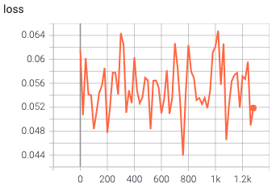
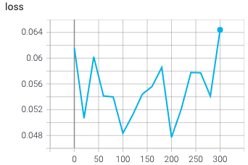
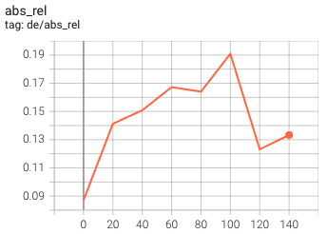
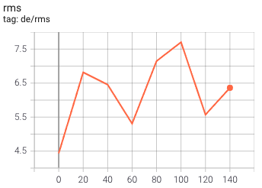
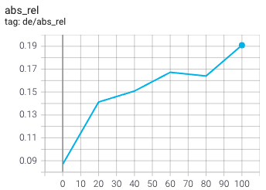

PriorDepth – KP3D Baseline
Training Curves
Validation Curves

Slide 44


PriorDepth – KP3D Baseline
Example visualizations
t-1
t
t+1

Slide 45
PriorDepth – Future Work
Debug the network to be sure 100% everything is correct
Additional visualizations for instance trajectory over time and warped images with estimated pose
Additional evaluation metrics in addition to calculated training and depth losses
For example: Pose & Depth accuracy
Training KP2D with MonoDepth2 together
Will implement Keypoint Loss
Training on an indoor dataset to show applicability in various conditions such as camera motion
Camera in KITTI is almost stay still
We may work on additional tasks as well, we will discuss :)

Slide 46
PriorDepth – Problem Statement
Problem: Robust depth map and pose estimation using keypoints in self-supervised training
Solutions:
MonoDepth2
Drawback: Pose Network does not work well in various scenes
KP2D
Drawback: Only using Homography Augmentations for 2D Warping
KP3D
Drawback: Does not use sparse triangulation for depth loss

Slide 47

PriorDepth – Setting up the Model
KP2D based
3D warping for Keypoint Detection with estimated depth map
Sparse depth triangulation for depth reconstruction loss
Joint Optimization of Depth Map and Keypoints
Build a KP3D based network
MonoDepth2 based

Slide 48
PriorDepth – Related Work
Related Work and existing Solutions
Task: Depth Estimation
StereoBM based on Epipolar Geometry
MonoDepth2
[1]
Task: Keypoint Matching
SIFT/ORB based features
KeyPoint2D
KeyPoint3D
[2]
[3]
Task: Ego-Motion Estimation
Non-Learning
Learning-based
[1] Clément Godard; Digging Into Self-Supervised Monocular Depth Estimation, ICCV 2018 [2] Jiexiong Tang; Neural Outlier Rejection for self-supervised keypoint learning, 2020
[3] Jiexiong Tang; Self-Supervised 3D Keypoint Learning for Ego-motion Estimation, 2020

Slide 49
Project PriorDepth – Conclusion
Our task: Robust and accurate Depth and Pose Estimation
What will be the (live) demo / prototype you want to show?
We want to show improved depth and ego-motion estimations

Slide 50
Project X – Overview
What is the general idea of the project?
How can it be summarized?
Think of TL;DR style

Slide 51
Project X – Motivation
Why is it relevant / interesting?
Where can it be used?
Who benefits from it?
What do you expect to learn?

Slide 52
Project X – Problem
Summarize the problem
Do solutions already exist?
What is your method / strategy to solve it?
Emphasize on why your method is suitable for it / what obstacles you see
Can it be split in sub-problems?

Slide 53
Project X – Initial Plan
Who is responsible for what?
When do you plan to be ready with X1, X2, …?
Plan more detailed until Project Update Presentations [15.06.2021]
What are the to-dos afterwards until Final Workshop [15.07.2021]?
What will be the (live) demo / prototype you want to show?

